Slide 1
Overview of Electronic Components:
LED, Diode, Zener, ESD, Relay, and Solenoid

Slide 2
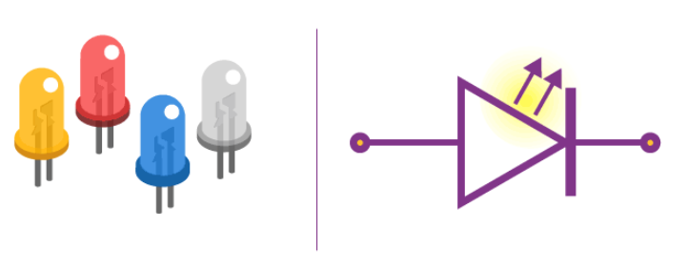
LED
What is LED?
A light-emitting diode (LED) is a semiconductor device that emits light when an electric current flows through it. When current passes through an LED, the electrons recombine with holes emitting light in the process. LEDs allow the current to flow in the forward direction and blocks the current in the reverse direction.
Light-emitting diodes are heavily doped p-n junctions. Based on the semiconductor material used and the amount of doping, an LED will emit coloured light at a particular spectral wavelength when forward biased. As shown in the figure, an LED is encapsulated with a transparent cover so that emitted light can come out.

Slide 3
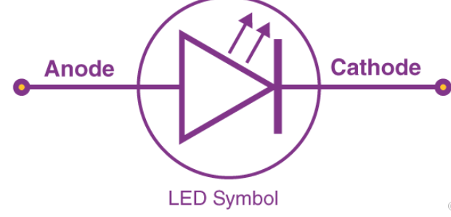
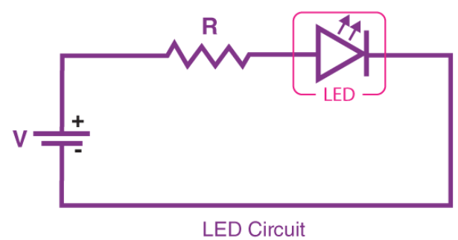
LED
LED Symbol
The LED symbol is the standard symbol for a diode, with the addition of two small arrows denoting the emission of light
Simple LED Circuit
The figure below shows a simple LED circuit.
The circuit consists of an LED, a voltage supply and a resistor to regulate the current and voltage.

Slide 4
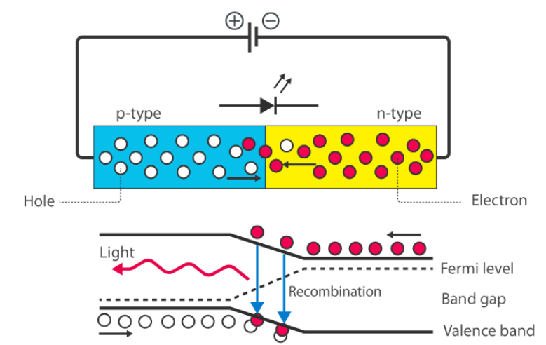
LED
How does an LED work?
When the diode is forward biased, the minority electrons are sent from p → n while the minority holes are sent from n → p. At the junction boundary, the concentration of minority carriers increases. The excess minority carriers at the junction recombine with the majority charges carriers.
The energy is released in the form of photons on recombination. In standard diodes, the energy is released in the form of heat. But in light-emitting diodes, the energy is released in the form of photons. We call this phenomenon electroluminescence. Electroluminescence is an optical phenomenon, and electrical phenomenon where a material emits light in response to an electric current passed through it. As the forward voltage increases, the intensity of the light increases and reaches a maximum.

Slide 5
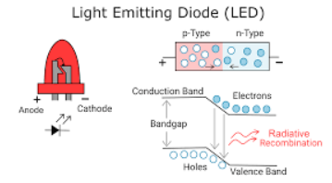
LED
Uses of LED
LEDs find applications in various fields, including optical communication, alarm and security systems, remote-controlled operations, robotics, etc. It finds usage in many areas because of its long-lasting capability, low power requirements, swift response time, and fast switching capabilities. Below are a few standards LED uses:
Used for TV back-lighting
Used in displays
Used in Automotives
LEDs used in the dimming of lights

Slide 6
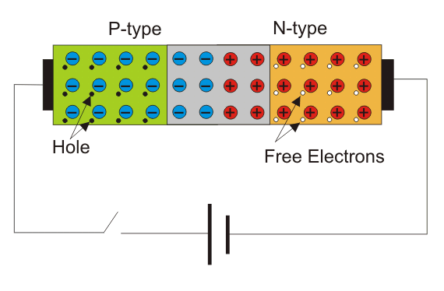
Diode
A diode is a 2-terminal, basic discreet electronic component, made up of semiconductor material, which allows a unidirectional flow of current through it, i.e it only conducts current in one direction. A diode is analogous to a uni-directional water flow valve, which allows the water to flow in one direction but restricts it to flow backward.
Diode consists of two terminals, named:
Anode (+).
Cathode (-).
These terminals are connected to two doping regions:
P-Type region.
N-Type region.

Slide 7
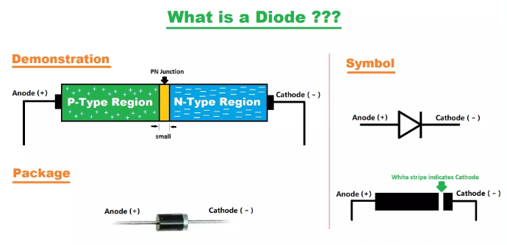
Diode
The P-Type region consists of positively charged ions called Holes, while the N-Type region consists of negatively charged electrons. We will discuss its construction in detail later.
In a diode, current flows from Anode to Cathode(diode acts as a closed switch), but if the current flows in the opposite direction(i.e. from Cathode to Anode), the diode will block it, so we can say, the diode is acting as an open switch.

Slide 8
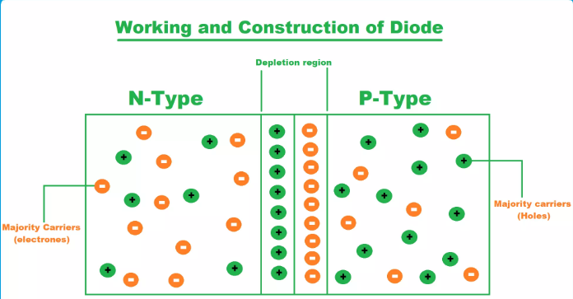
Construction of a diode
A diode is normally made up of a semiconductor material i.e. silicon, germanium, gallium arsenide etc.
Two crystals of the same semiconductor material(normally silicon) are doped with different types of impurities, one crystal with pentavalent impurity, while the second one with trivalent, to create two types of semiconductor materials named:
P-Type Semiconductor: Majority Charge Carriers are Holes(+).
N-Type Semiconductor: Majority Charge Carriers are Electrons(-).
When these two semiconductors are joined/merged together, the free electrons from the N-Type start to move towards the P-Type region, while the Holes start moving towards the N-Type region.
At the border of these two regions, electrons get combined with Holes and neutralized.These neutralized atoms create a layer at the border(of N-Type & P-Type regions) and stop the flow of electrons & Holes. This newly created third layer/region is called the depletion region.
The depletion region is very small in size and acts as a barrier for the flow of charge carriers(i.e. electrons & Holes) from the N-type to P-type region.

Slide 9
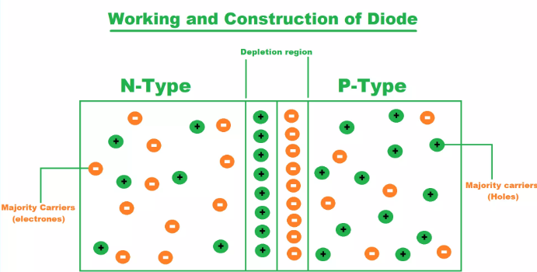
Construction of a diode
we have 3 regions in a final diode, named:
N-Type Region: Majority Charge Carriers are Electrons(-).
P-Type Region: Majority Charge Carriers are Holes(+).
Depletion Region: No Charge(Neutral).
when two semiconductor materials are merged together, a momentary flow of charge carriers occurs, which results in the creation of a depletion region. This state of the diode is normally termed as Zero Biasing State, as there's no power applied at any terminal. In operational mode, the diode has two other biasing states, named as:
Forward biased.
Reverse biased.

Slide 10
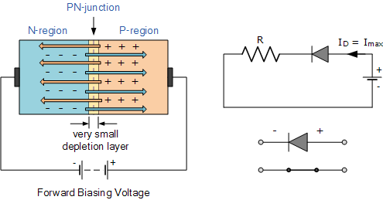
Diode As Forward Biased
The PN Junction created at the center of two regions is very small but it's powerful enough to stop the free electrons from passing through it.
So, if we could provide some external power to these electrons, they can break this barrier and can make their entry into the P-Type region.
This external power required to overcome the depletion region is normally termed as a Forward Threshold Voltage of diode.
This threshold voltage value depends on the semiconductor material used in the diode construction i.e. for silicon it's +0.7V and for Germanium, it's +0.3V.

Slide 11
Diode As Forward Biased
So, for a normal diode, if we provide an external power of +0.7V, the electrons will overcome the depletion region and in simple words, the current will start flowing through the diode.
As you can see in the below figure, the positive terminal of the battery is connected with the anode of the diode and as we will provide a voltage greater than its threshold voltage, the diode will start conducting and is said to be acting as forward biased.
In forward biasing conditions, an ideal diode has zero resistance, but as I told you earlier, an ideal condition does not exist.

Slide 12
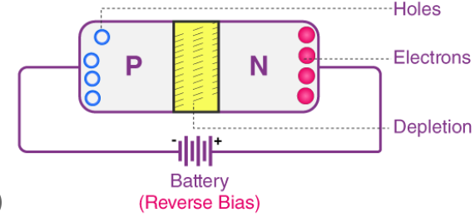
Diode As Reverse Biased
If the polarity of the applied power is reversed i.e. positive terminal of the battery gets connected with the cathode(-), while the negative terminal gets connected with the anode(+), the depletion region will start to increase.
In this state, the diode won't allow the current to flow through it and is said to be acting as reverse biased.
In a reverse Biased state, the diode acts as an open switch.
The PN junction in reverse biasing offers a very high resistance due to the thickness of the depletion region.
A diode in ideal condition when reverse biased has infinite resistance.

Slide 13
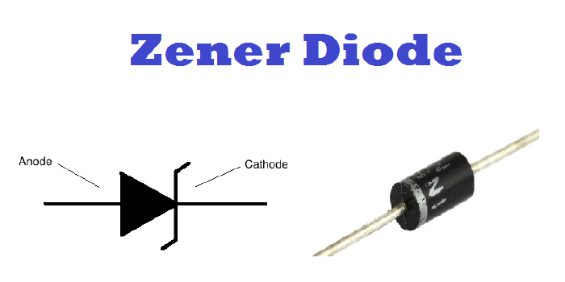
Zener Diode
A Zener diode is a highly doped semiconductor device specifically designed to function in the reverse direction. It is engineered with a wide range of Zener voltages (Vz), and certain types are even adjustable to achieve variable voltage regulation.
How does a Zener Diode work in reverse bias?
A Zener diode functions similarly to a regular diode when forward-biased. However, in reverse-biased mode, a small leakage current flows through the diode. As the reverse voltage increases and reaches the predetermined breakdown voltage (Vz), current begins to flow through the diode. This current reaches a maximum level determined by the series resistor, after which it stabilizes and remains constant across a wide range of applied voltages.
There are two types of breakdowns in a Zener Diode: Avalanche Breakdown and Zener Breakdown.

Slide 14
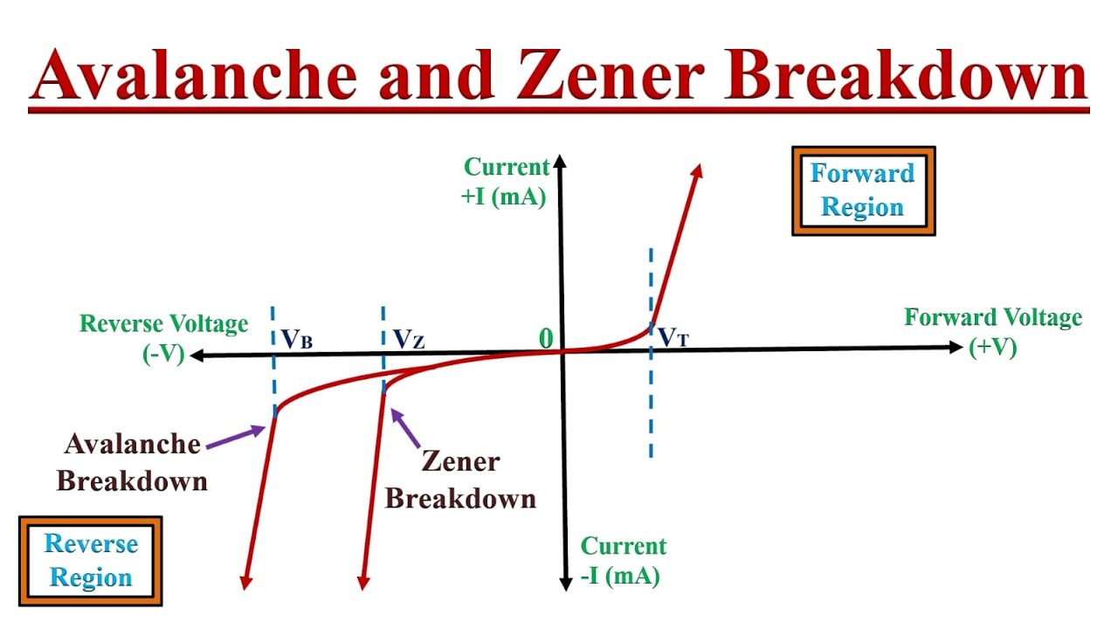
Avalanche Breakdown in Zener Diode
Avalanche breakdown occurs in both normal diodes and Zener diodes when subjected to high reverse voltage. When a significant reverse voltage is applied to the PN junction, the free electrons gain enough energy to accelerate at high velocities. These high-velocity electrons collide with other atoms, causing the ejection of additional electrons. This continuous collision process generates a large number of free electrons, resulting in a rapid increase in electric current through the diode. In the case of a normal diode, this sudden surge in current could permanently damage it. However, a Zener diode is specifically designed to withstand avalanche breakdown and can handle the sudden current spike. Avalanche breakdown typically occurs in Zener diodes with a Zener voltage (Vz) greater than 6V.

Slide 15
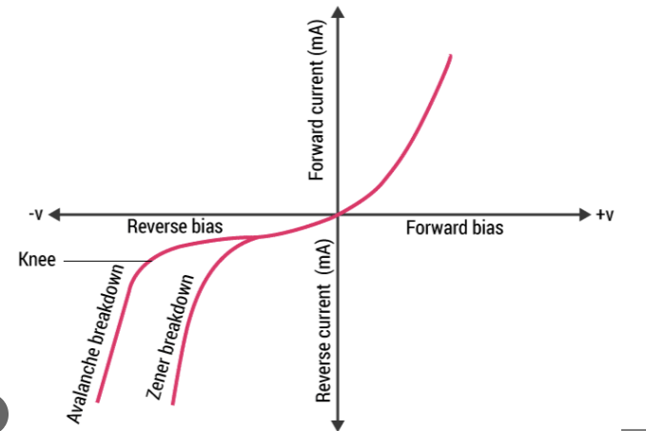
Zener Breakdown in Zener Diode
When the reverse bias voltage applied to a Zener diode approaches its Zener voltage, the electric field within the depletion region becomes strong enough to attract and remove electrons from their valence band. These valence electrons, energized by the intense electric field, break free from their parent atoms. This phenomenon takes place in the Zener breakdown region, where even a slight increase in voltage leads to a rapid surge in electric current.

Slide 16
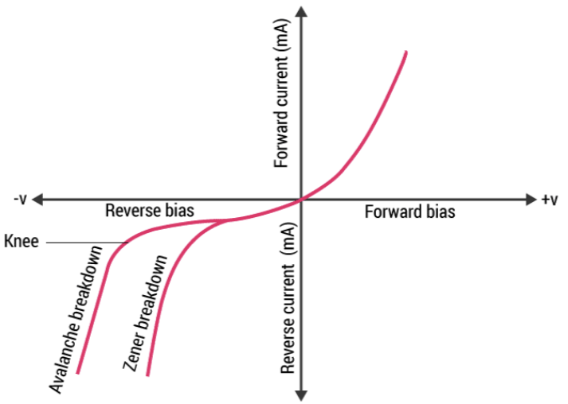
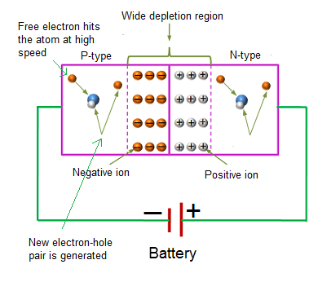
V-I Characteristics of Zener Diode

Slide 17
Zener Diode Specifications
Some commonly used specifications for Zener diodes are as follows:
Zener/Breakdown Voltage – The Zener or the reverse breakdown voltage ranges from 2.4 V to 200 V, sometimes it can go up to 1 kV while the maximum for the surface-mounted device is 47 V.
Current Iz (max) – It is the maximum current at the rated Zener Voltage (Vz – 200μA to 200 A)
Current Iz (min) – It is the minimum value of current required for the diode to break down.
Power Rating – It denotes the maximum power the Zener diode can dissipate. It is given by the product of the voltage of the diode and the current flowing through it.
Temperature Stability – Diodes around 5 V have the best stability
Voltage Tolerance – It is typically ±5%
Zener Resistance (Rz) – It is the resistance to the Zener diode exhibits.

Slide 18
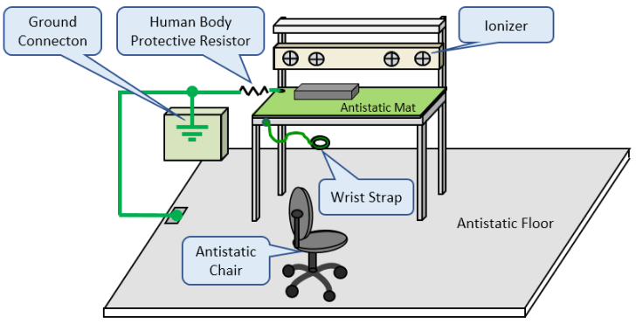
ESD (Electrostatic Discharge)
What is an electrostatic discharge?
Electrostatic discharge (ESD) is the release of static electricity when two objects come into contact. Familiar examples of ESD include the shock we receive when we walk across a carpet and touch a metal doorknob and the static electricity we feel from clothes coming out of the dryer. Lightning is also electrostatic discharge.
While most of ESD events are harmless to the human body, they can cause challenging and expensive problems in certain industrial environments. Static electricity is a problem for electronic and medical device manufacturing, vehicle fabrication, industries that use plastics and paper, and ones that need clean room environments. ESD issues can slow production, negatively affect product quality issues, attract contaminants and create safety issues

Slide 19
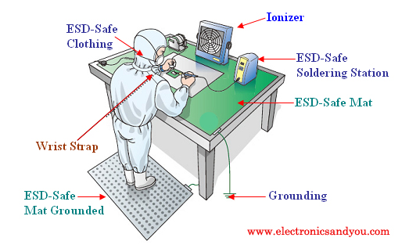
What causes an electrostatic discharge?
An ESD event reflects a buildup of an electrostatic charge. This occurs when two different conductive materials, or conductors, rub together. One of the materials becomes positively charged; the other takes on a negative charge. The positively charged material now has an electrostatic charge. When the electrically charged object comes into contact with another conductive material, such as a Styrofoam cup or plastic bag, a static charge is transferred and an ESD event occurs.

Slide 20
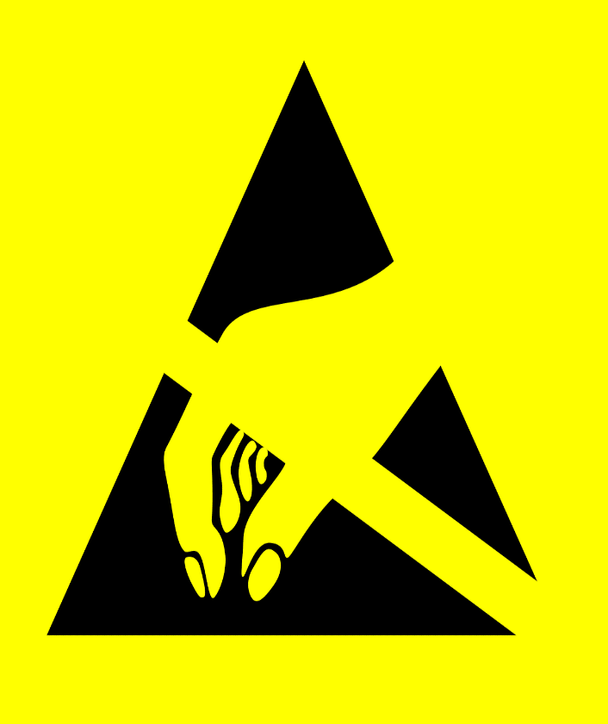
How to manage and prevent ESD
Preventing electrostatic discharges (ESD) is crucial in electronics manufacturing and usage. Manufacturers implement ESD protection measures, including:
Incorporating ESD-safe furnishings and equipment.
Ensuring proper grounding according to ANSI standards.
Using personal grounding tools like wrist straps and antistatic footwear.
Covering floors with antistatic mats to direct charges away.
Storing devices in static-reducing containers and packaging materials.
Applying antistatic spray where necessary.
Using static-minimized areas for components prone to static attraction.
Avoiding contact with metallic parts, wires, and connectors.
Removing unnecessary components from static-protected workspaces.

Slide 21
ESD standards
ESD standards play a crucial role in addressing electrostatic discharge control issues and defining protective measures for sensitive electronic environments. Some key ESD standards include:
ANSI/ESD S20.20-2021: Focuses on the protection of electrical and electronic parts.
IEC 61340-5-1: An international standard outlining general requirements for protecting electronic devices from electrostatic phenomena.
ANSI/ESD S8.1-2021: Sets standards for the protection of electrostatic discharge susceptible items, including symbols.
ANSI/ESD S6.1-2019: Addresses electrostatic discharge grounding.
ANSI/ESD S541-2019: Specifies standards for packaging ESD-susceptible materials.

Slide 22
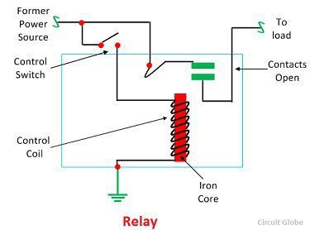
Relay
The relay is the device that open or closes the contacts to cause the operation of the other electric control. It detects the intolerable or undesirable condition with an assigned area and gives the commands to the circuit breaker to disconnect the affected area. Thus protects the system from damage.
Working Principle of Relay
It works on the principle of an electromagnetic attraction. When the circuit of the relay senses the fault current, it energises the electromagnetic field which produces the temporary magnetic field. This magnetic field moves the relay armature for opening or closing the connections. The small power relay has only one contacts, and the high power relay has two contacts for opening the switch.

Slide 23
Working Principle of Relay
The inner section of the relay is shown in the figure below. It has an iron core which is wound by a control coil. The power supply is given to the coil through the contacts of the load and the control switch. The current flows through the coil produces the magnetic field around it.
Due to this magnetic field, the upper arm of the magnet attracts the lower arm. Hence close the circuit, which makes the current flow through the load. If the contact is already closed, then it moves oppositely and hence open the contacts.

Slide 24
Construction Detail of relay
Pole and Throw:
Defines relay configurations, where the pole is the switch, and throw is the number of connections. For instance, a single pole, single throw has one switch and connection, while a single pole, double throw has one switch and two connections.
Construction of Relay:
Relays operate electrically and mechanically, consisting of electromagnetic components and contact sets. Construction involves four key aspects:
Contacts: Essential for reliability, with material selection based on factors like current nature, magnitude, frequency, and voltage.
Bearing: Types include single ball, multi-ball, pivot-ball, and jewel bearing, influencing sensitivity, friction, and shock resistance.
Electromechanical Design: Involves designing the magnetic circuit and mechanical attachment, with soft iron for the electromagnet and limited coil current and voltage.
Terminations and Housing: Assembly of armature, magnet, and base using insulating springs for dimensional stability, with fixed contacts typically spot welded on the terminal link.

Slide 25
What Is a Solenoid?
Electromagnets
Electromagnets are the kind of magnet where the wire is wrapped around an iron core. Upon the supply of electric current, a magnetic field is created around the iron core. The magnetic field vanishes when the electric supply is cut off. The core of the magnet that is wound by wires is ferromagnetic or ferrimagnetic in nature. Iron is the most commonly used material in the core.
The magnetic field established is controlled by the supply of electricity. A permanent magnet does not need the supply of power, and the magnetic field cannot be controlled. Electromagnets are used in making solenoids, MRI machines, hard disks, relays, motors, loudspeakers, and generators.
Now that we have understood electromagnets, let us learn about solenoids.
The solenoid is a type of electromagnet, the purpose of which is to generate a controlled magnetic field through a coil wound into a tightly packed helix. The solenoid is as shown in the figure below. The solenoid is a coil of wire, and the plunger is made of soft iron. The magnetic field is formed around the coil when an electric current passes through it and draws the plunger in. We can say that the solenoid is responsible for converting electrical energy into mechanical work.

Slide 26
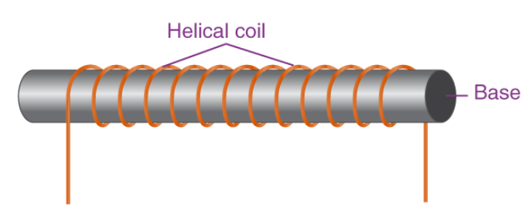
Solenoid Figure

Slide 27
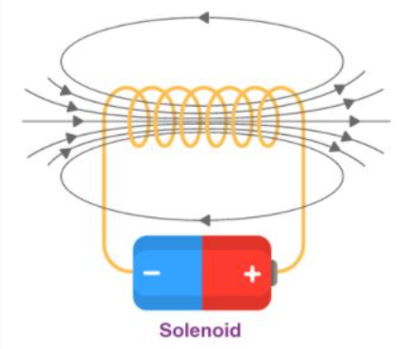
Working of Solenoids
Operates on electromagnetism; electric current in the coil generates a magnetic field. Placing a metal core inside concentrates magnetic flux on the core, enhancing electromagnetic induction.
Coil Construction: Coils, made of tightly wound copper wire, create a strong magnetic flux. Increasing current flow or turn density amplifies solenoid magnetic strength.
Housing and Plunger: Housing, typically iron or steel, is enveloped by the coil's magnetic field. The plunger, within the solenoid, facilitates mechanical force for work. Positive and negative poles attract or repel objects.
Solenoid Configuration: With a length surpassing the radius, enameled and insulated wire forms a helical coil with a small gap between turns. The vector force from each turn equals the total magnetic field, resembling that of a circular loop.

Slide 28
Types Of Solenoid
AC-Laminated Solenoid:
Features a metal core and wire coil.
Known for significant force in the first stroke.
Utilizes laminated metal core to reduce stray current.
Capable of multiple strokes, producing a clean buzzing sound.
DC C-Frame Solenoid:
Configured in a C-shape around the coil.
Suitable for DC applications but compatible with AC power equipment.

